Slide 1
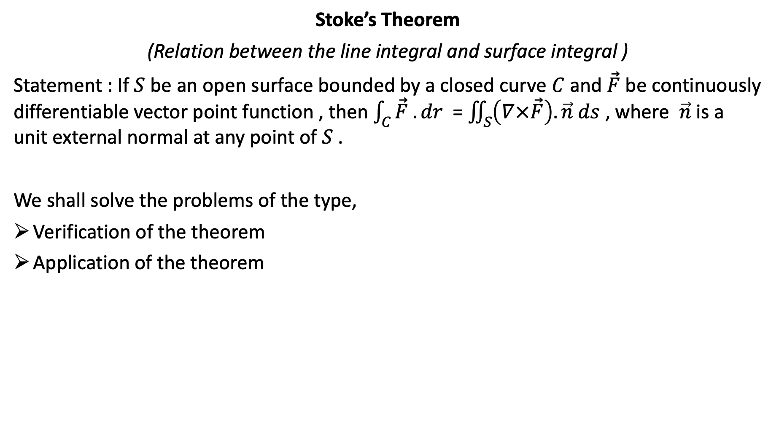
Stoke’s Theorem
(Relation between the line integral and surface integral )
Statement : If $S$ be an open surface bounded by a closed curve $C$ and $\vec{F}$ be continuously differentiable vector point function , then $\int_{C}{\vec{F} . dr }$ = $\iint_{S}{\left(∇×\vec{F}\right). \vec{n} ds}$ , where $\vec{n}$ is a unit external normal at any point of $S$ .
We shall solve the problems of the type,
Verification of the theorem
Application of the theorem

Slide 2
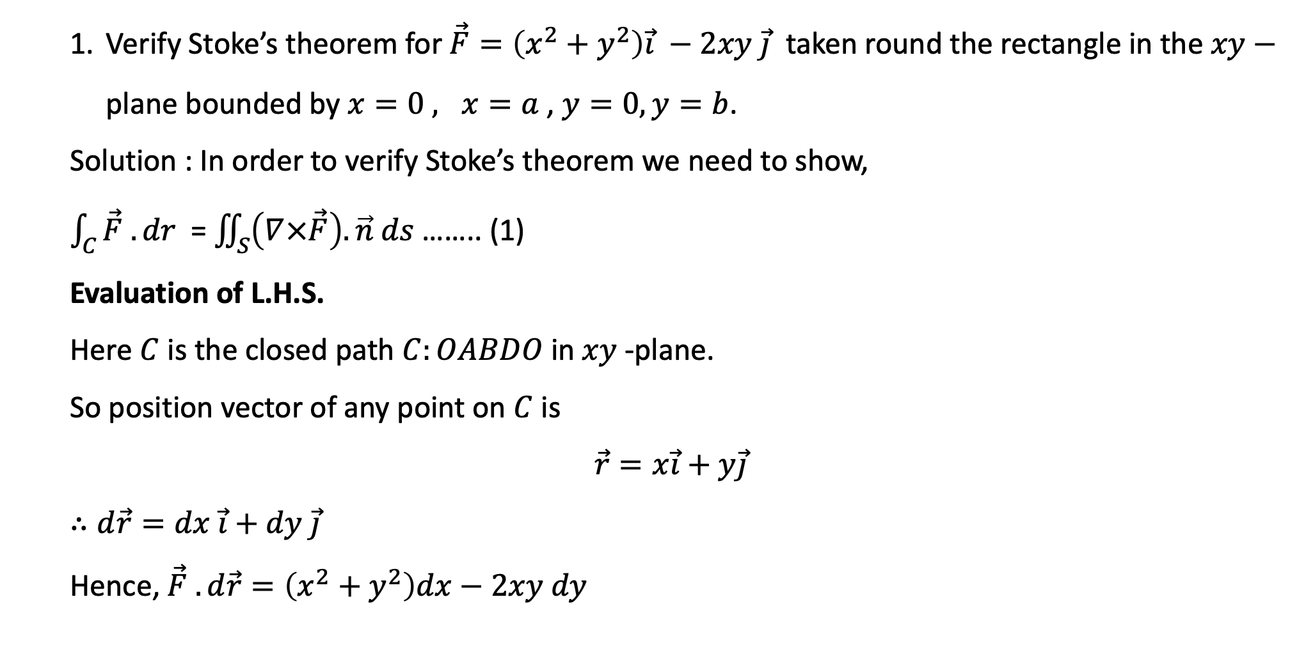
Verify Stoke’s theorem for $\vec{F}=\left(x^{2}+y^{2}\right)\vec{i} −2xy \vec{j}$ taken round the rectangle in the $xy−$ plane bounded by $x=0 , x=a$ , $y=0, y=b$.
Solution : In order to verify Stoke’s theorem we need to show,
$\int_{C}{\vec{F} . dr }$ = $\iint_{S}{\left(∇×\vec{F}\right). \vec{n} ds}$ …….. (1)
Evaluation of L.H.S.
Here $C$ is the closed path $C:OABDO$in $xy$-plane.
So position vector of any point on $C$ is
$$\vec{r}=x\vec{i}+y\vec{j}$$
$∴d\vec{r}=dx \vec{i}+dy \vec{j}$
Hence, $\vec{F} . d\vec{r}=\left(x^{2}+y^{2}\right)dx−2xy dy$
Y
y=b
B(a, b)
D(0,b)
x=0
x=a
X
O(0,0)
y=0
A(a,0)

Slide 3
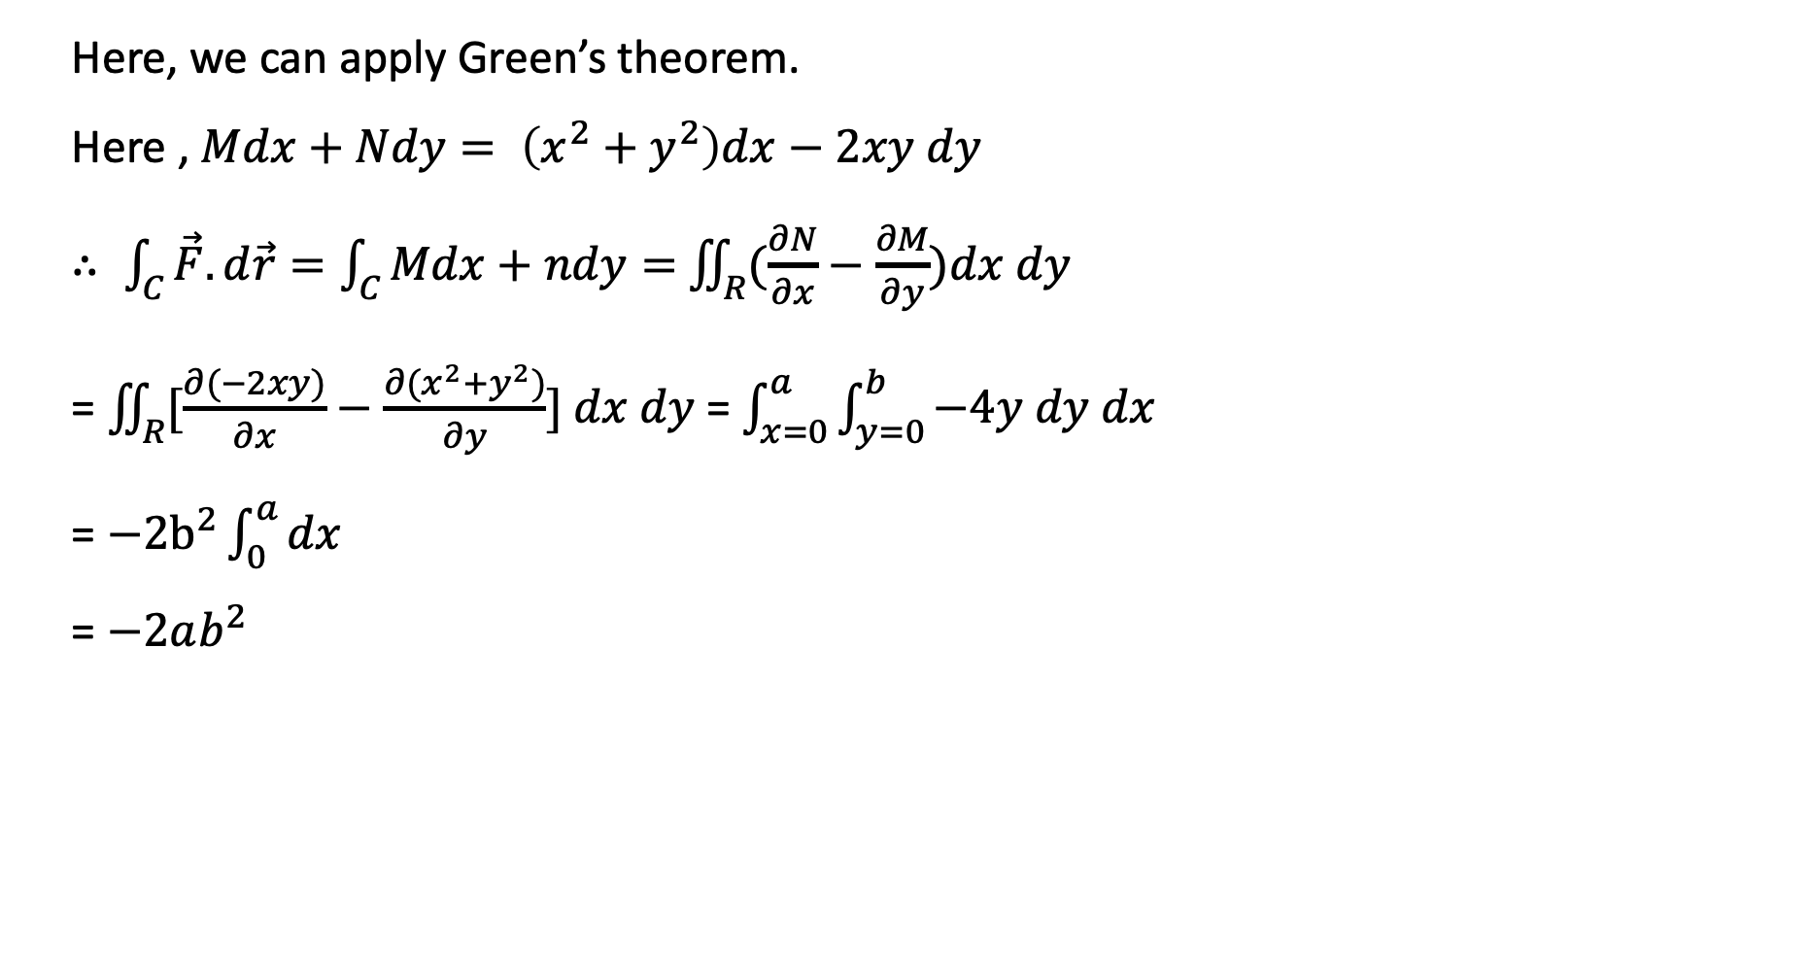
Here, we can apply Green’s theorem.
Here , $Mdx+Ndy= \left(x^{2}+y^{2}\right)dx−2xy dy$
$∴ \int_{C}{\vec{F}.d\vec{r}=\int_{C}{Mdx+ndy=}}$ $\iint_{R}{(\frac{∂N}{∂x}}−\frac{∂M}{∂y})dx dy$
= $\iint_{R}{[\frac{∂(−2xy)}{∂x}}−\frac{∂{(x}^{2}+y^{2})}{∂y}] dx dy$= $\int_{x=0}^{a}{\int_{y=0}^{b}{−4y dy dx}}$
= $−2b^{2}\int_{0}^{a}{dx}$
= $−2ab^{2}$

Slide 4
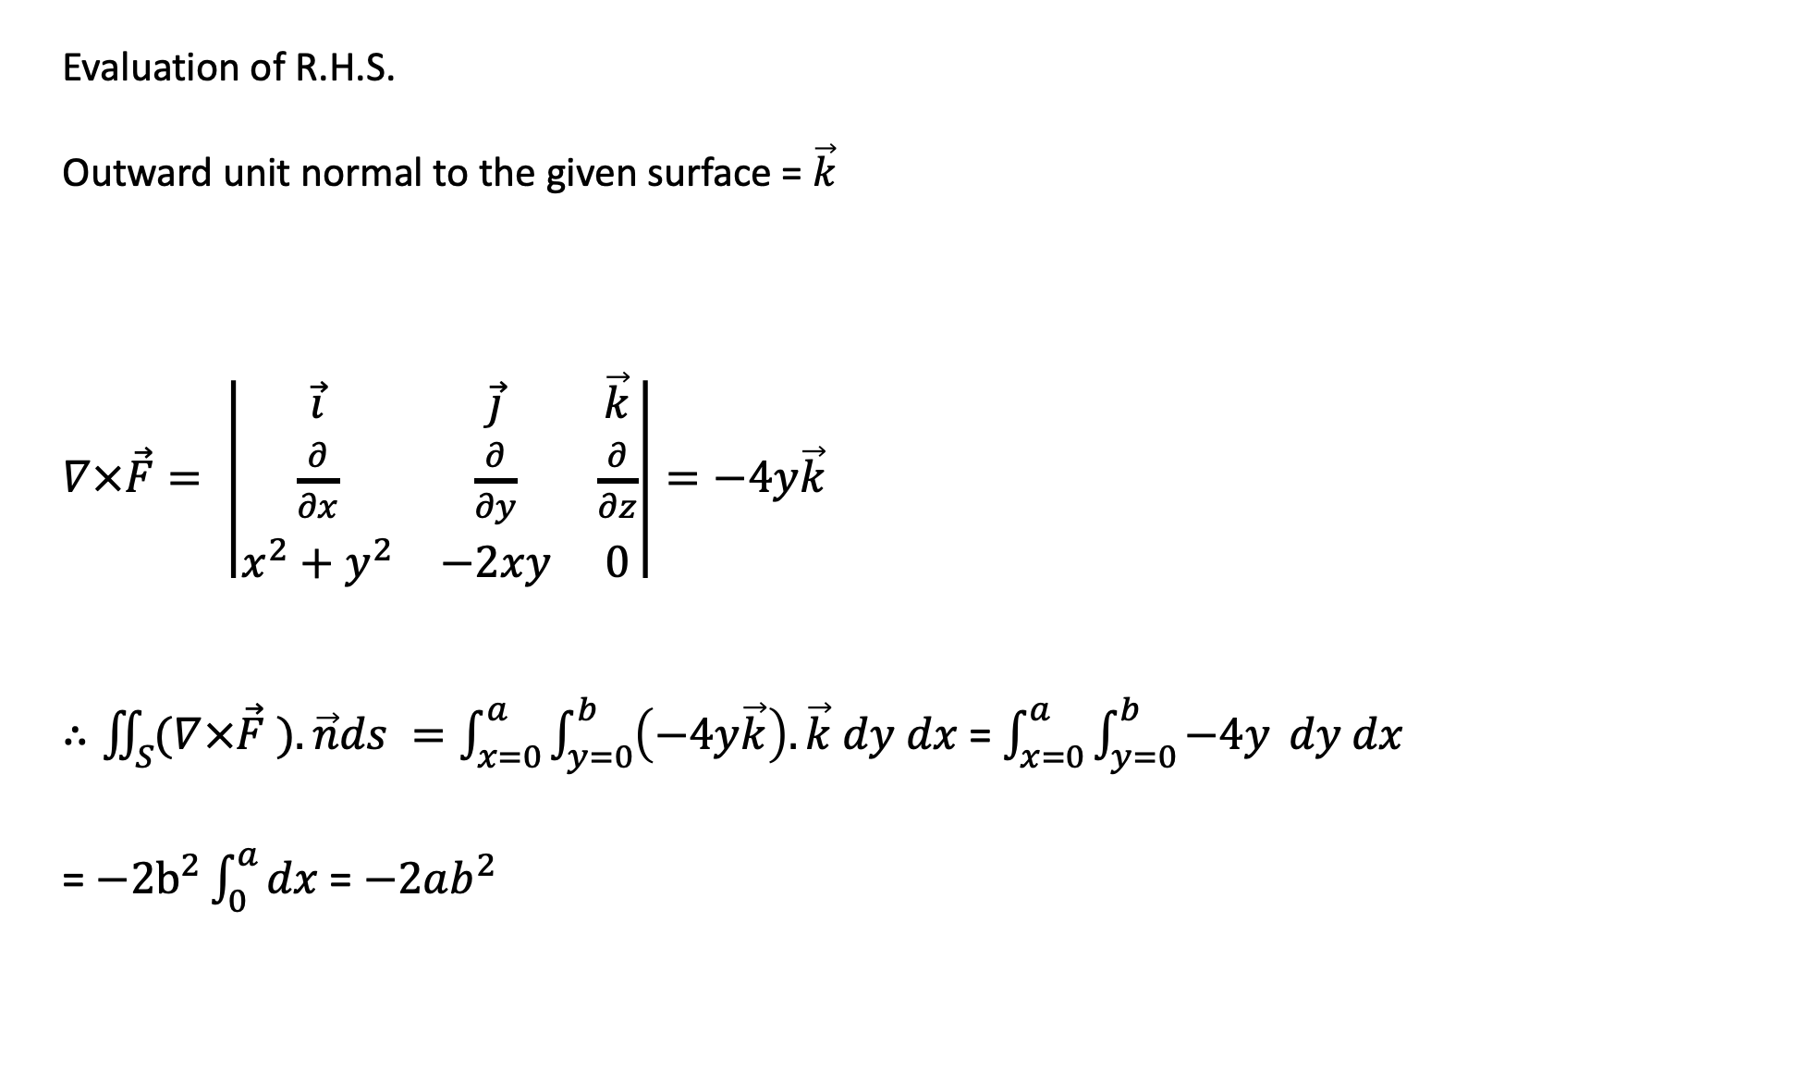
Evaluation of R.H.S.
Outward unit normal to the given surface = $\vec{k}$
$∇×\vec{F}= \left|\begin{matrix}\vec{i} & \vec{j} & \vec{k} \\ \frac{∂}{∂x} & \frac{∂}{∂y} & \frac{∂}{∂z} \\ x^{2}+y^{2} & −2xy & 0\end{matrix}\right|=−4y\vec{k}$
$∴\iint_{S}{(∇×\vec{F}} ).\vec{n}ds =\int_{x=0}^{a}{\int_{y=0}^{b}{\left(−4y\vec{k}\right).}}\vec{k} dy dx$ = $\int_{x=0}^{a}{\int_{y=0}^{b}{−4y}} dy dx$
= $−2b^{2}\int_{0}^{a}{dx }$= $−2ab^{2}$

Slide 5
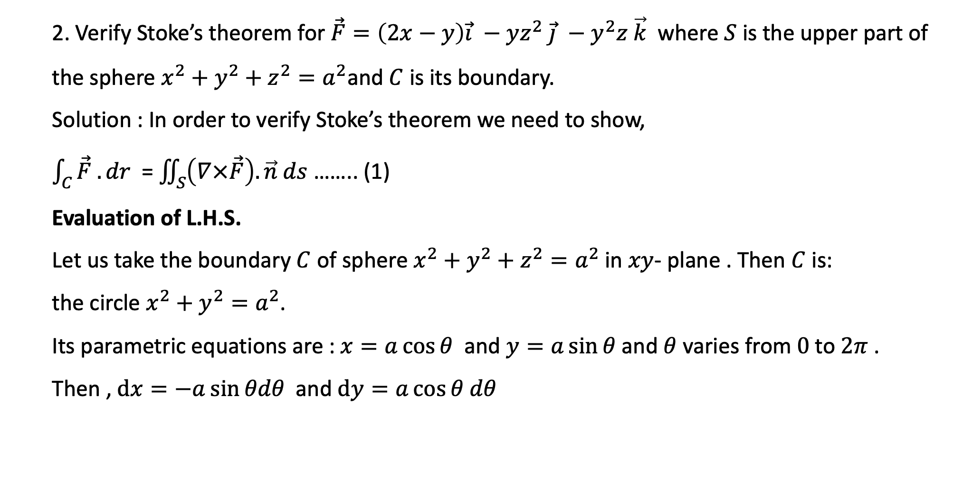
2. Verify Stoke’s theorem for $\vec{F}=\left(2x−y\right)\vec{i} −yz^{2} \vec{j} −y^{2}z \vec{k}$ where $S$ is the upper part of the sphere $x^{2}+y^{2}+z^{2}=a^{2}$and $C$ is its boundary.
Solution : In order to verify Stoke’s theorem we need to show,
$\int_{C}{\vec{F} . dr }$ = $\iint_{S}{\left(∇×\vec{F}\right). \vec{n} ds}$ …….. (1)
Evaluation of L.H.S.
Let us take the boundary $C$ of sphere $x^{2}+y^{2}+z^{2}=a^{2}$ in $xy$- plane . Then $C$ is:
the circle $x^{2}+y^{2}=a^{2}$.
Its parametric equations are : $x=a\cos{θ }$ and $y=a\sin{θ}$ and $θ$ varies from $0$to $2π$ .
Then , $dx=−a\sin{θdθ }$ and $dy=a\cos{θ dθ}$

Slide 6
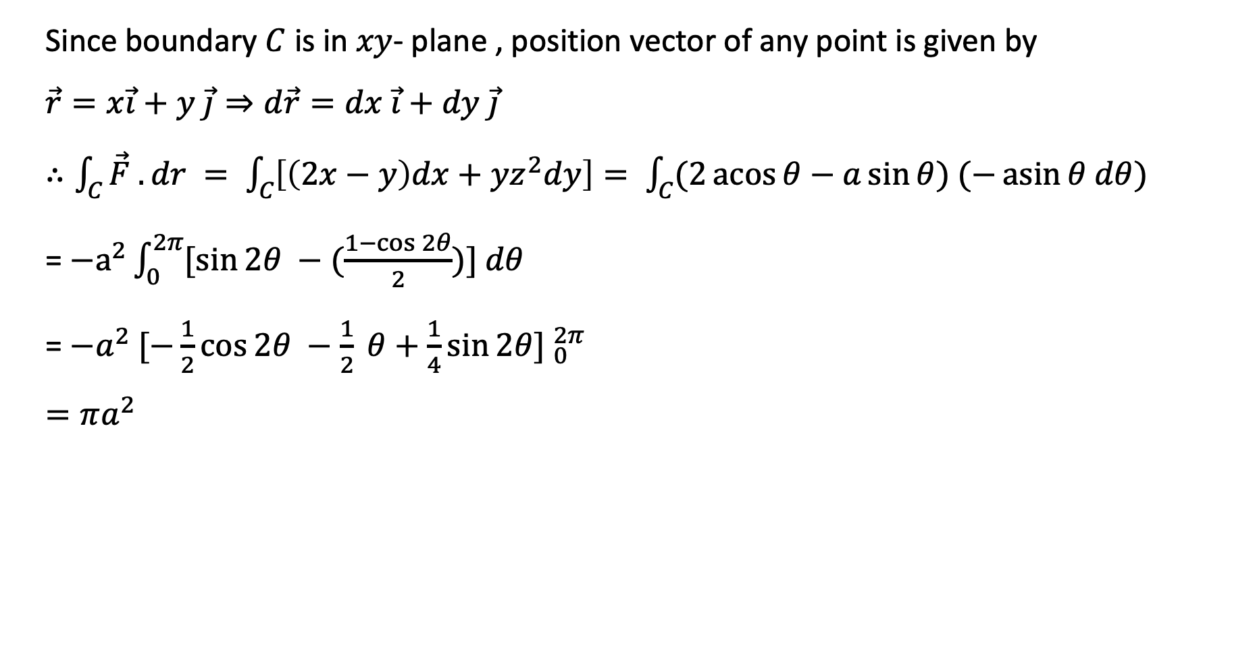
Since boundary $C$ is in $xy$- plane , position vector of any point is given by
$\vec{r}=x\vec{i}+y \vec{j}⇒d\vec{r}=dx \vec{i}+dy \vec{j}$
$∴\int_{C}{\vec{F} . dr }= \int_{C}{\left[\left(2x−y\right)dx+yz^{2}dy\right]= \int_{C}{(2}}\operatorname{acos}{θ−a\sin{θ) (−\operatorname{asin}{θ dθ)}}}$
= ${−a}^{2}\int_{0}^{2π}{[\sin{2θ −(\frac{1−\cos{2θ}}{2}}})] dθ$
= ${−a}^{2} {[−\frac{1}{2}\cos{2θ −\frac{1}{2} θ+\frac{1}{4}\sin{2θ] }}}_{0}^{2π}$
$=πa^{2}$

Slide 7
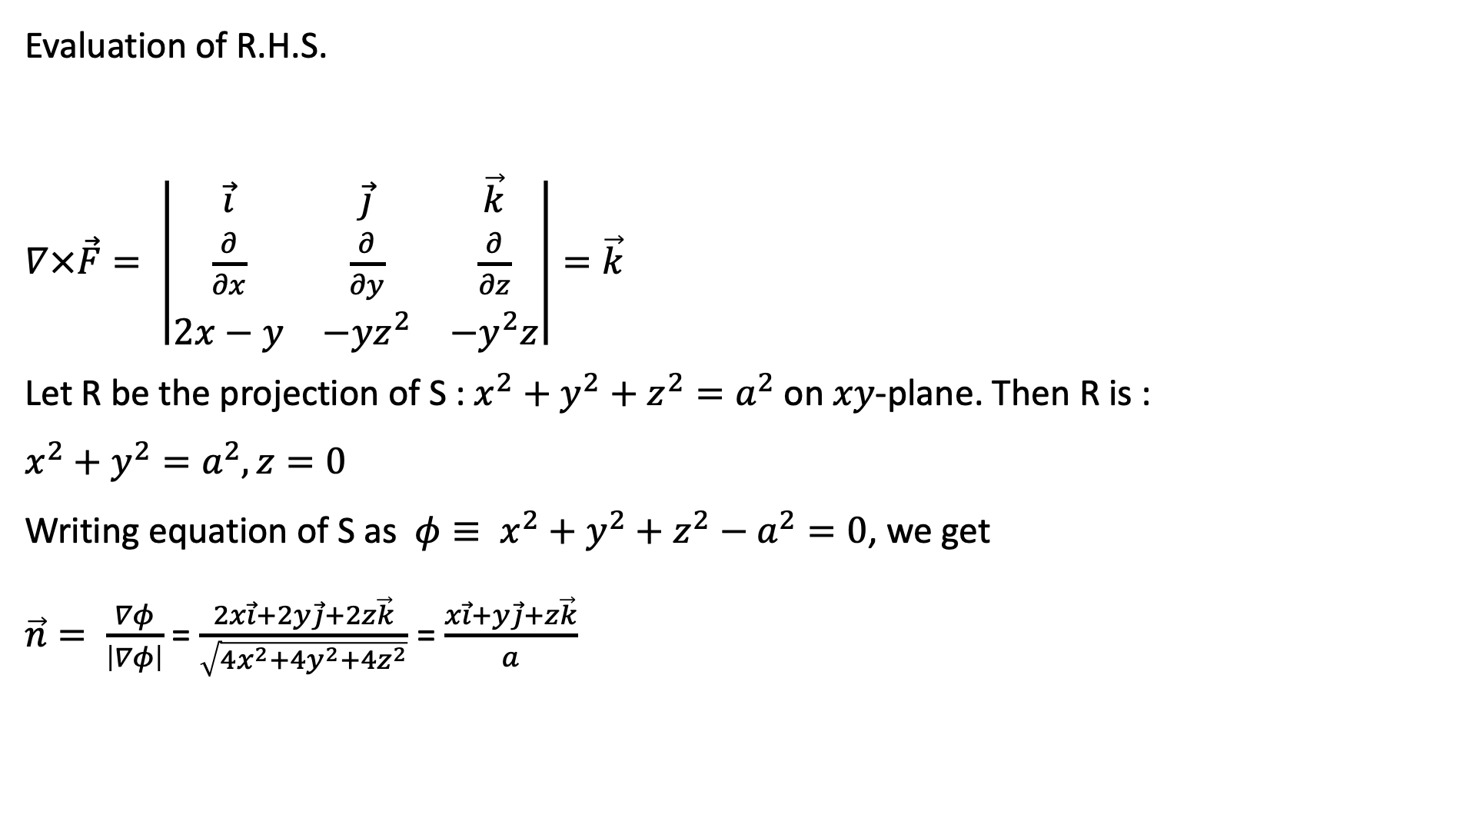
Evaluation of R.H.S.
$∇×\vec{F}= \left|\begin{matrix}\vec{i} & \vec{j} & \vec{k} \\ \frac{∂}{∂x} & \frac{∂}{∂y} & \frac{∂}{∂z} \\ 2x−y & −yz^{2} & −y^{2}z\end{matrix}\right|=\vec{k}$
Let R be the projection of S : $x^{2}+y^{2}+z^{2}=a^{2}$ on $xy$-plane. Then R is :
$x^{2}+y^{2}=a^{2}, z=0$
Writing equation of S as ${φ≡ x}^{2}+y^{2}+z^{2}−a^{2}=0$, we get
$\vec{n}= \frac{∇φ}{\left|∇φ\right|}$ = $\frac{2x\vec{i}+2y\vec{j}+2z\vec{k}}{\sqrt{4x^{2}+4y^{2}+4z^{2}}}$ = $\frac{x\vec{i}+y\vec{j}+z\vec{k}}{a}$

Slide 8
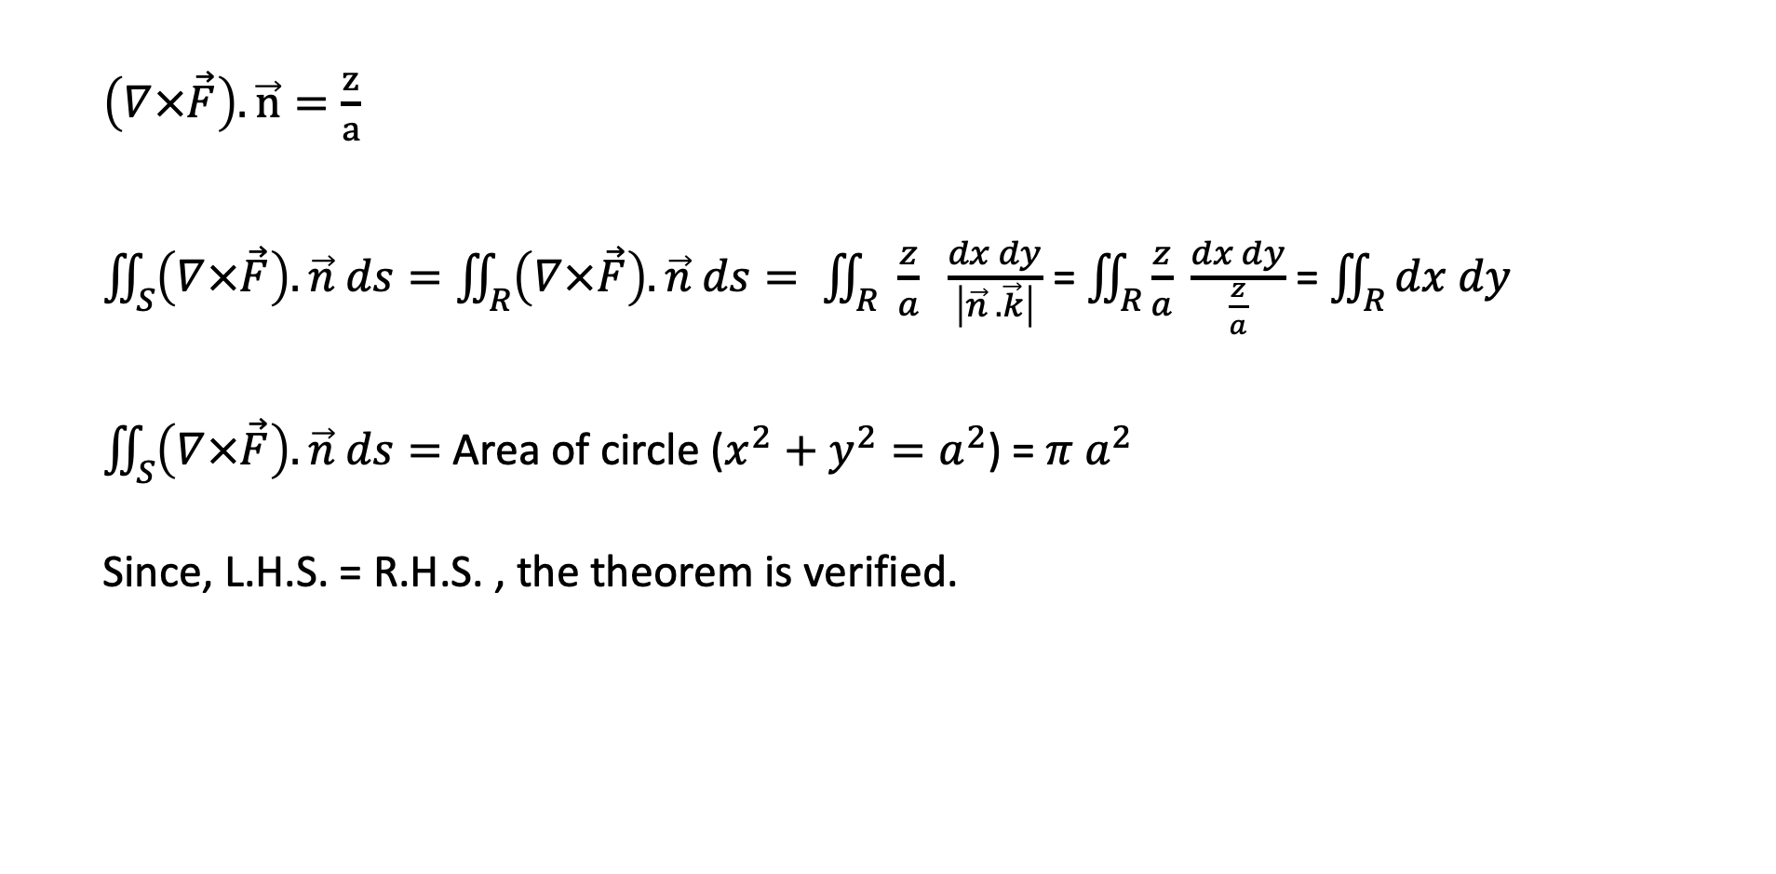
$\left(∇×\vec{F}\right).\vec{n}=\frac{z}{a}$
$\iint_{S}{\left(∇×\vec{F}\right). \vec{n} ds}=\iint_{R}{\left(∇×\vec{F}\right). \vec{n} ds}= \iint_{R}{ \frac{z}{a} \frac{dx dy}{\left|\vec{n} .\vec{k}\right|}}$ = $\iint_{R}{\frac{z}{a} \frac{dx dy}{\frac{z}{a}}}$ = $\iint_{R}{dx dy}$
$\iint_{S}{\left(∇×\vec{F}\right). \vec{n} ds}=$Area of circle ($x^{2}+y^{2}=a^{2}$) = $π a^{2}$
Since, L.H.S. = R.H.S. , the theorem is verified.

Slide 9
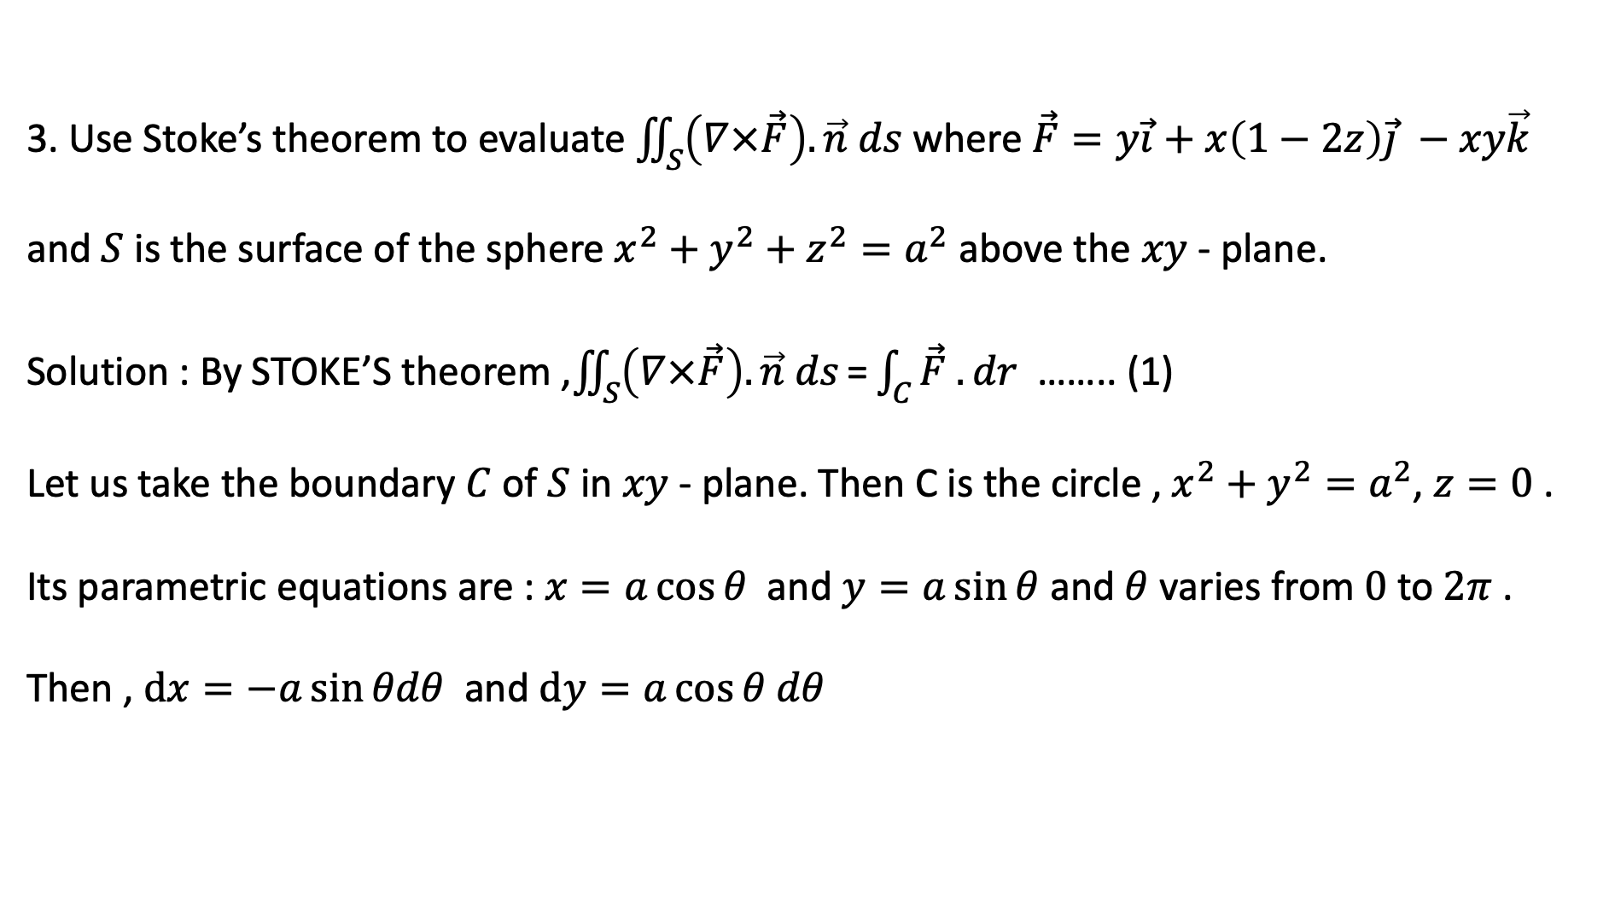
3. Use Stoke’s theorem to evaluate $\iint_{S}{\left(∇×\vec{F}\right).\vec{n} ds}$ where $\vec{F}=y\vec{i}+x\left(1−2z\right)\vec{j} −xy\vec{k}$ and $S$ is the surface of the sphere $x^{2}+y^{2}+z^{2}=a^{2}$ above the $xy$ - plane.
Solution : By STOKE’S theorem ,$\iint_{S}{\left(∇×\vec{F}\right). \vec{n} ds}\text{=}\int_{C}{\vec{F} . dr }$ …….. (1)
Let us take the boundary $C$ of $S$ in $xy$ - plane. Then C is the circle , $x^{2}+y^{2}=a^{2}$, $z=0$ .
Its parametric equations are : $x=a\cos{θ }$ and $y=a\sin{θ}$ and $θ$ varies from $0$to $2π$ .
Then , $dx=−a\sin{θdθ }$ and $dy=a\cos{θ dθ}$

Slide 10

Since boundary $C$ is in $xy$- plane , position vector of any point is given by
$\vec{r}=x\vec{i}+y\vec{j}⇒d\vec{r}=dx \vec{i}+dy \vec{j}$
$∴\int_{C}{\vec{F} . dr }= \int_{C}{\left[ydx+xdy\right] }$= $\int_{C}{d(xy)}$ = $\int_{0}^{2π}{d(\operatorname{acos}{θ . a\sin{θ)} }}$
= ${[a^{2}\cos{θ.\sin{θ] }}}_{0}^{2π}$
= $0$

Slide 11
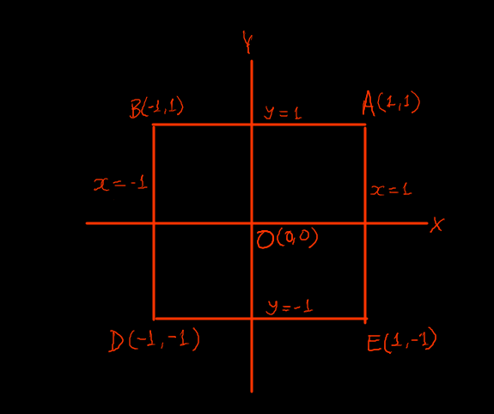
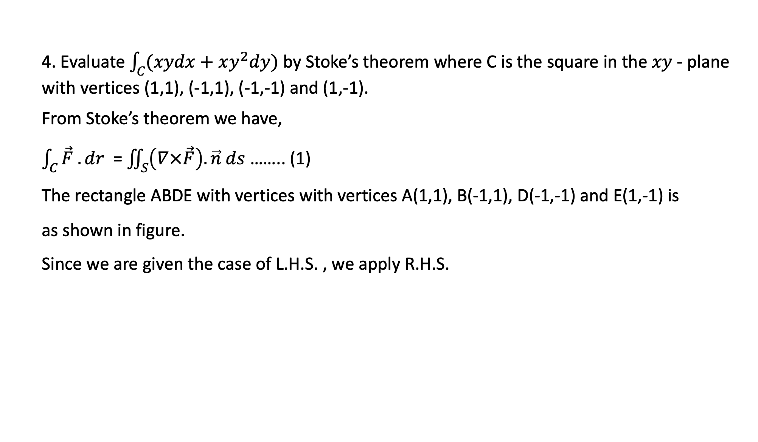
4. Evaluate $\int_{C}{(xydx+xy^{2}dy)}$ by Stoke’s theorem where C is the square in the $xy$ - plane with vertices (1,1), (-1,1), (-1,-1) and (1,-1).
From Stoke’s theorem we have,
$\int_{C}{\vec{F} . dr }$ = $\iint_{S}{\left(∇×\vec{F}\right). \vec{n} ds}$ …….. (1)
The rectangle ABDE with vertices with vertices A(1,1), B(-1,1), D(-1,-1) and E(1,-1) is
as shown in figure.
Since we are given the case of L.H.S. , we apply R.H.S.

Slide 12

Now, $\left(∇×\vec{F}\right)= \left|\begin{matrix}\vec{i} & \vec{j} & \vec{k} \\ \frac{∂}{∂x} & \frac{∂}{∂y} & \frac{∂}{∂z} \\ xy & xy^{2} & 0\end{matrix}\right|=\left(y^{2}−x\right)\vec{k}$
Clearly, $\vec{n}=\vec{k}$ , so $\left(∇×\vec{F}\right). \vec{n}=\left(y^{2}−x\right)\vec{k}. \vec{k}=(y^{2}−x)$
$\iint_{S}{\left(∇×\vec{F}\right). \vec{n} ds}=\iint_{S}{(y^{2}−x)ds}$ = $\int_{x=−1}^{1}{\int_{y=−1}^{1}{\left(y^{2}−x\right) dy dx=2\int_{x=−1}^{1}{{\left[\frac{y^{3}}{3}−xy\right]}_{0}^{1}}}dx}$
$= 2\int_{x=−1}^{1}{\left(\frac{1}{3} −x\right)}dx$
= $4\int_{0}^{1}{\frac{1}{3} dx}$ = $\frac{4}{3}$

